Slide 1










Hospital Database Management system
Created By :
Ruthvika Reddy Tangirala
Tejaswini Chavan
Arvind Ram Mahesh
Lokesh Sridhar
Naveen Babu

Slide 2
Table of Contents
Database Objective
Table Level Check Constraints
Business Rules
Computes Column
Workflow
Encrypted Column
Entities
Views
ERD
Visualizations
Database Implementation
Conclusion

Slide 3

Database Objective
This database is designed to fulfill various healthcare requirements and to keep a detailed record of hospital-related data. It helps in documenting and accessing information about patients, appointments, medical records, and interactions with insurance and pharmacies.
Additionally, it supports hospital administrative tasks by keeping track of staff, rooms, and equipment. This comprehensive system of maintaining the database will serve the needs of healthcareproviders, administrative staff, and insurance handlers to maintain a good quality of patient care,streamlined hospital workflows which can improvise the overall healthcare services.

Slide 4
Business Rules
There will be only one appointment id for the combination of patient id, doctor id, date and time.
Each patient has only one primary insurance.
There can be multiple medications associated with each medical record.
Each appointment can only have one medical record.
Each staff can only be associated with one department.

Slide 5
Workflow
In the Hospital Management System (HMS), the workflow between entities starts with patient registration at the reception desk, followed by appointment scheduling with healthcare providers. During medical consultations, doctors access patient records and may prescribe treatment or prescription. Test orders are sent electronically to labs, and results are uploaded to the system. Treatment plans and prescriptions are documented and sent to the pharmacy. After services are rendered, patients proceed to billing, and payment is recorded. Follow-up appointments are scheduled, and reminders are sent through the HMS. Data collected supports reporting and analytics for performance monitoring and quality improvement.

Slide 6
Workflow
In the Hospital Management System (HMS), the workflow between entities starts with patient registration at the reception desk, followed by appointment scheduling with healthcare providers. During medical consultations, doctors access patient records and may prescribe treatment or prescription. Test orders are sent electronically to labs, and results are uploaded to the system. Treatment plans and prescriptions are documented and sent to the pharmacy. After services are rendered, patients proceed to billing, and payment is recorded. Follow-up appointments are scheduled, and reminders are sent through the HMS. Data collected supports reporting and analytics for performance monitoring and quality improvement.

Slide 7

Entities
Patient
Appointment
Medical Record
Pharmacy
Staff
Doctor
Nurse
Payroll
Department
Prescription
Medication
Room
Insurance
Treatment
Laboratory Tests
Billing

Slide 8
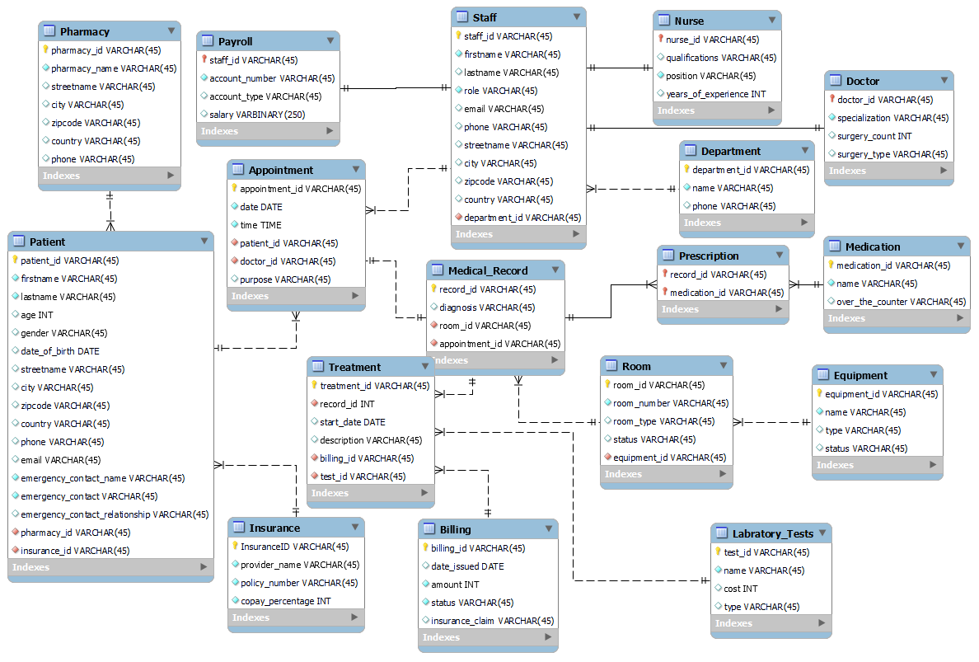

ERD

Slide 9
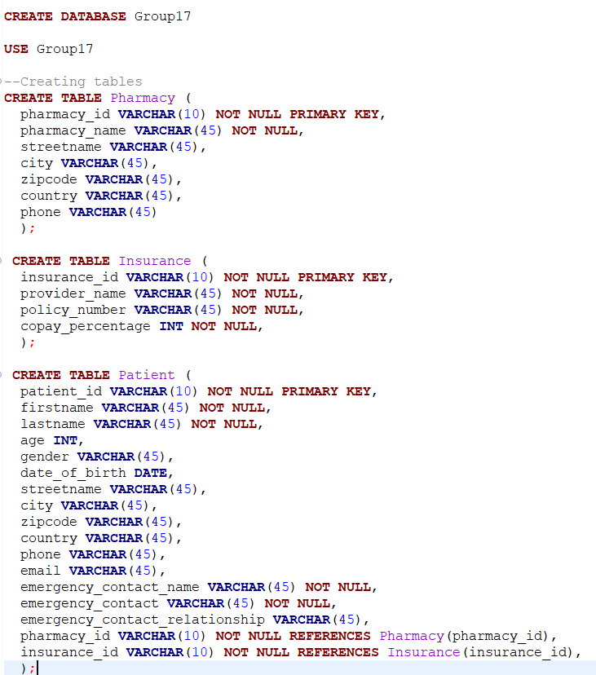
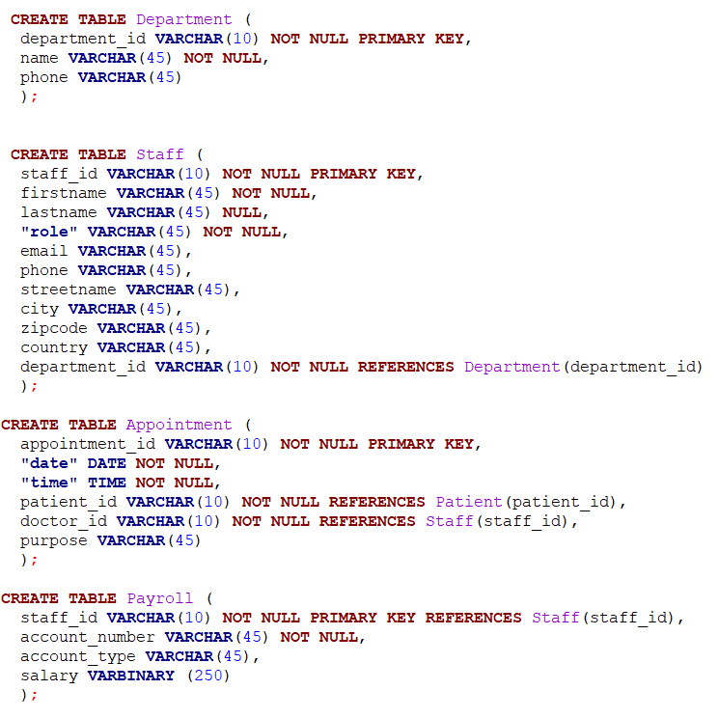

Database Implementation

Slide 10
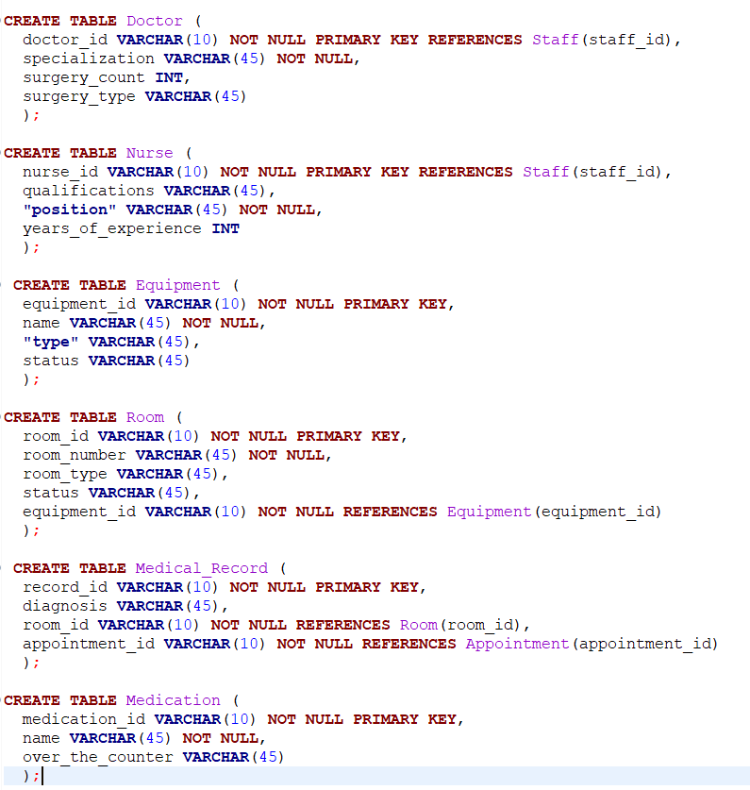
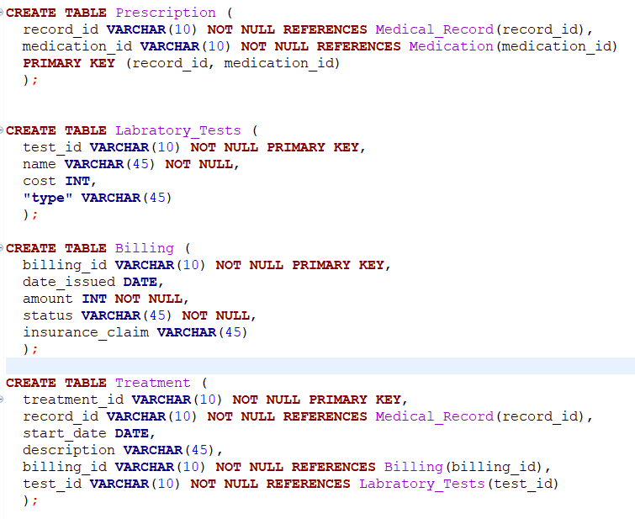
Database Implementation

Slide 11
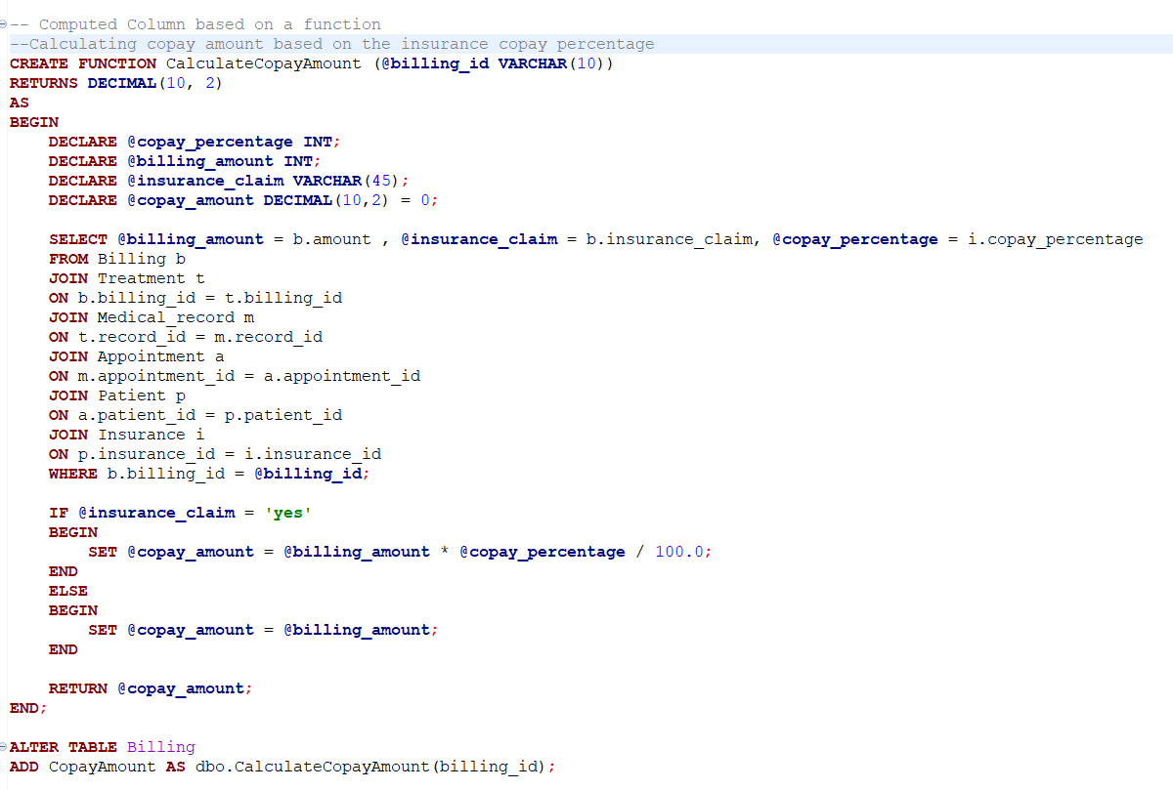
Computed Column based On a Function

Slide 12
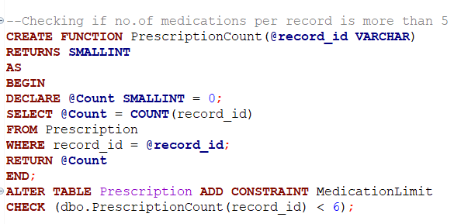
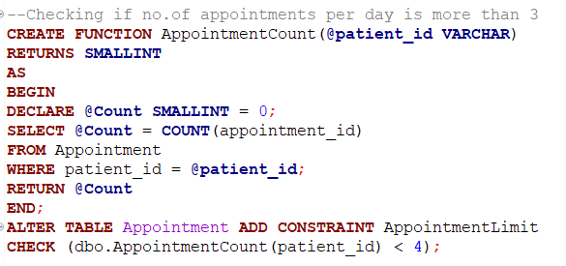
Table level Check Constraint
Medications for a particular record are restricted to a maximum of 5 medications
Appointments for a particular patient is capped at 3 in one day

Slide 13
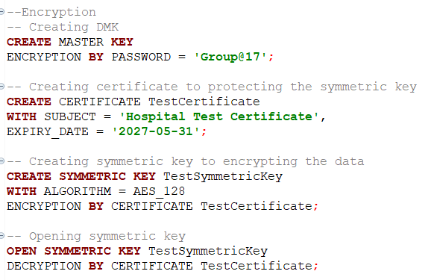


Encryption
Creating the Encryption key
Salary Column in the payroll table has been encrypted to maintain the privacy of the staff
Looking at Values without Decrypting
Looking at Values After Decrypting

Slide 14
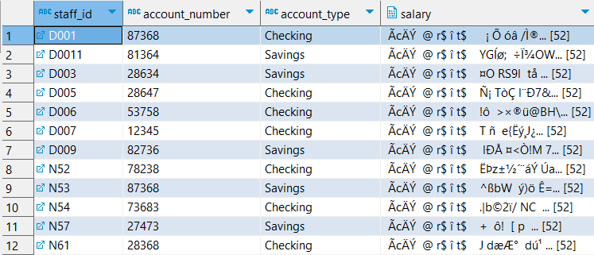
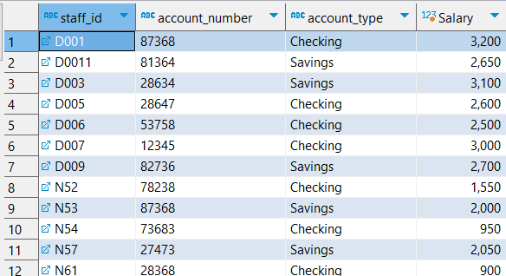
Encryption
Viewing data Without Decrypting
Viewing data After Decrypting

Slide 15
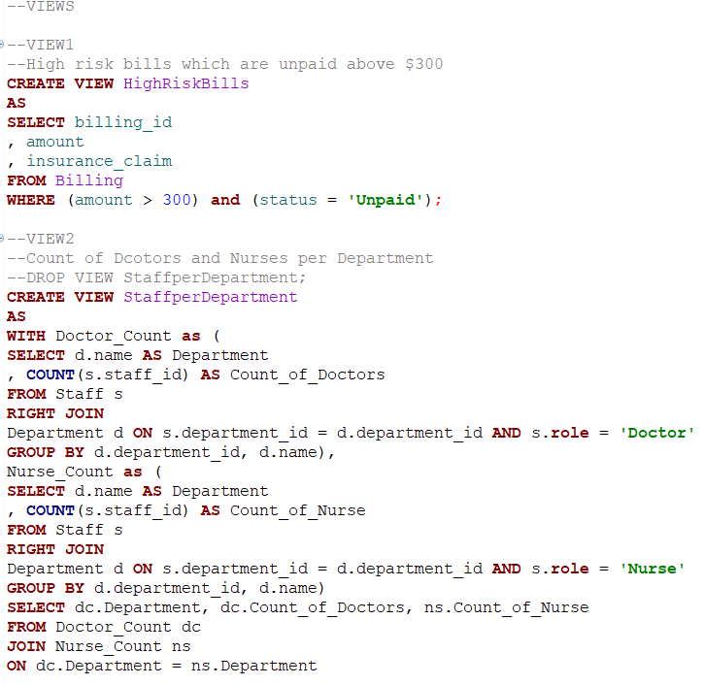
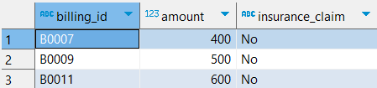
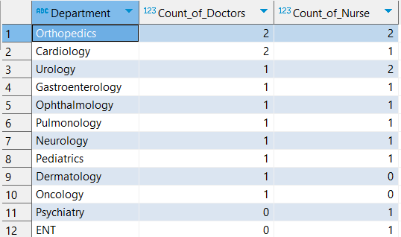
Views

Slide 16
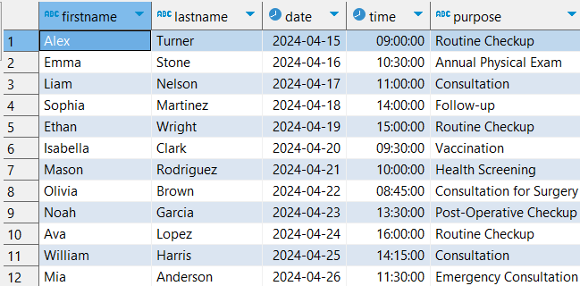
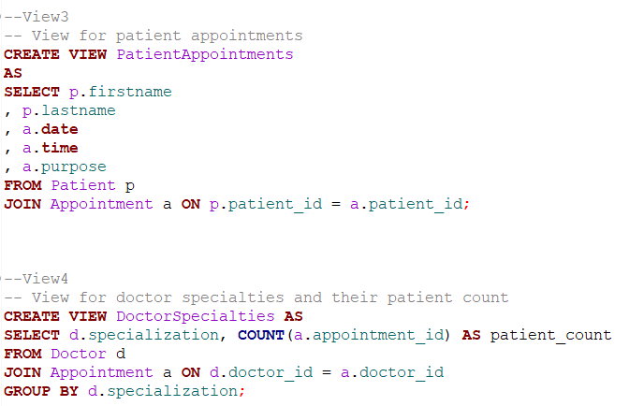
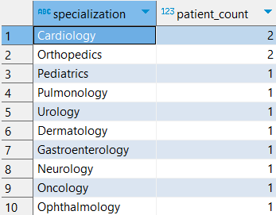
Views
To view all the patient's appointments and their purpose
Number of patients In the Specialization

Slide 17
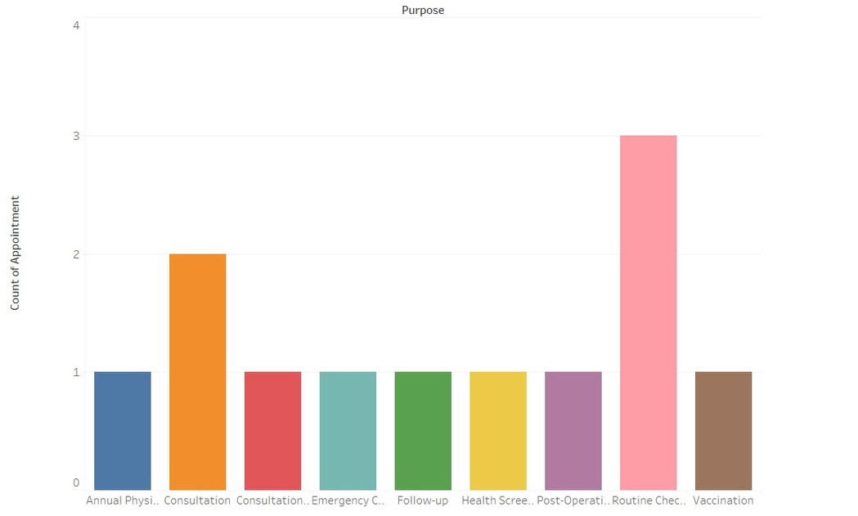
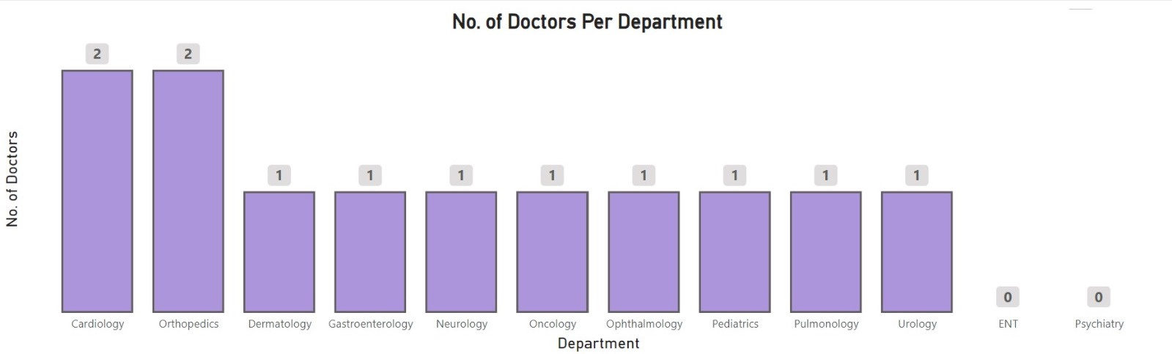
Visualization
Most of our patients are coming for regular checkups, followed by consultation
We don’t have any doctors in the ENT and Psychiatry departments, which needs to be filled

Slide 18
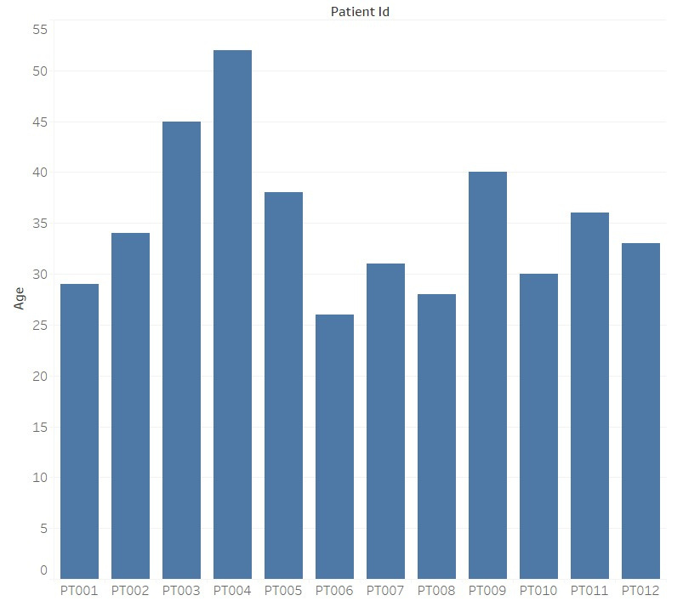
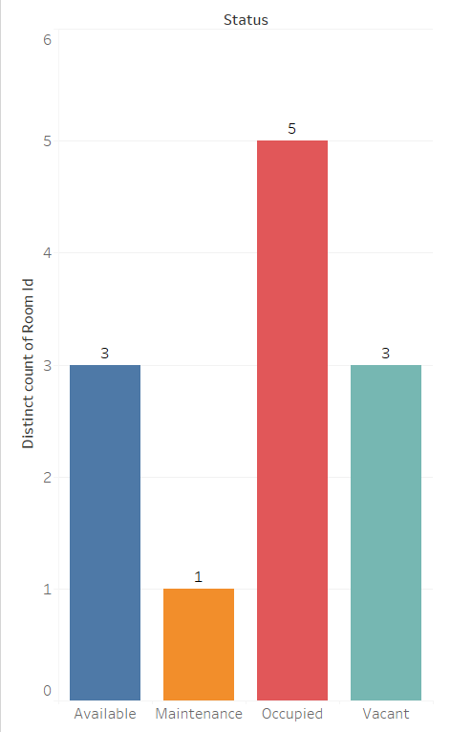

Visualization

Slide 19
Thank you for your attention

